Slide 1
Practical Layouts in HTML + CSS
Mike Blatter

Slide 2
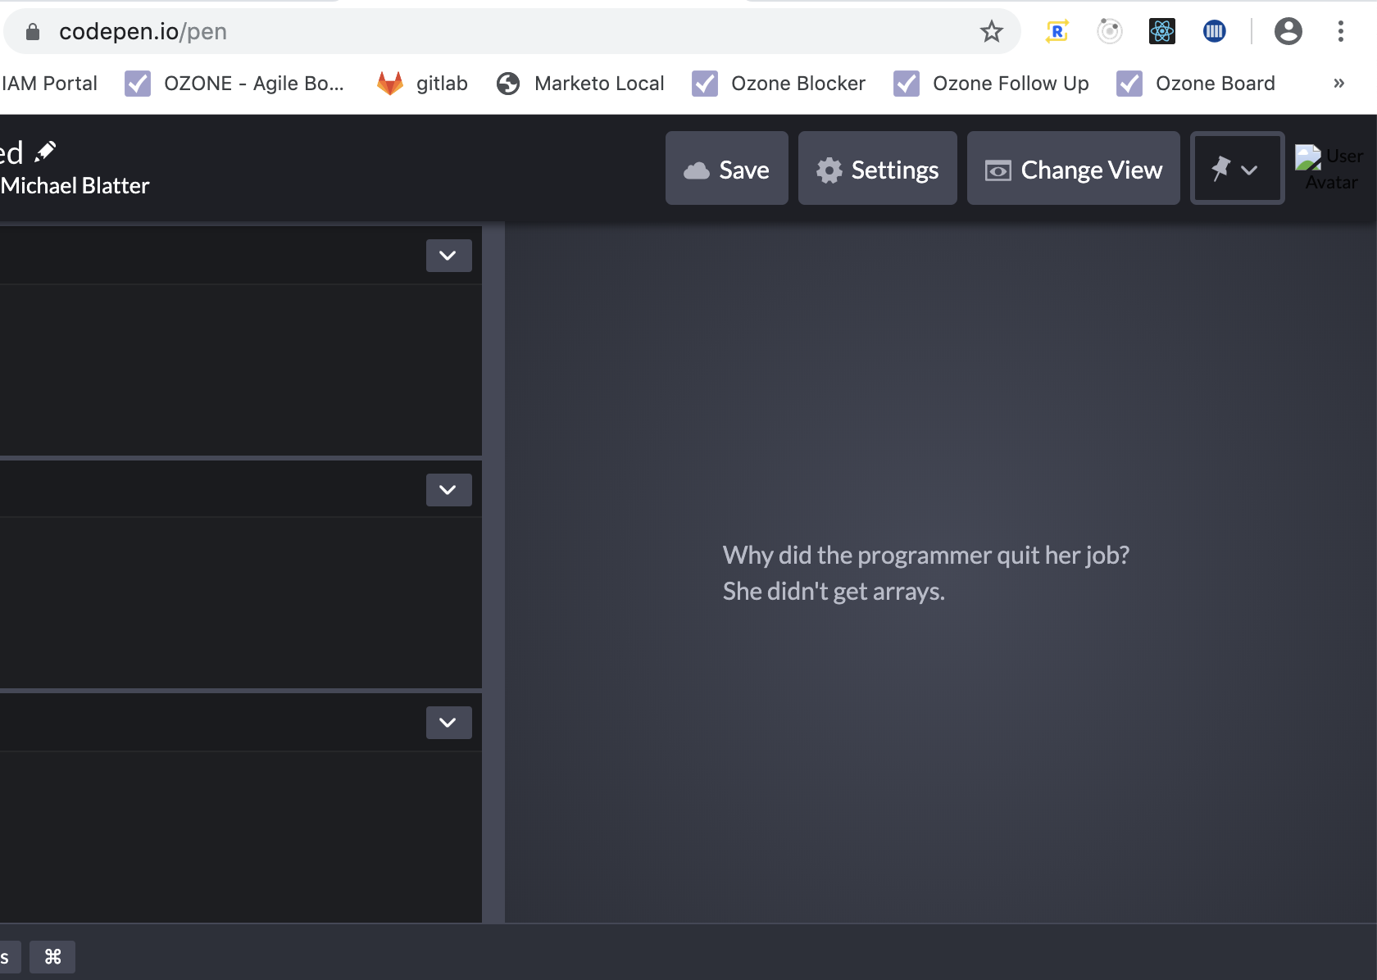
Demo In CodePen
First PowerPoint Overview
Then will present examples in CodePen
Included CodePen links in git, will share

Slide 3
Legacy Layouts
Tables
Floats
Positioning
All incomplete solutions to laying out an interface

Slide 4
Modern Web Layout Systems
Flexbox
1 dimensional layout system
Content First
Grid
2 dimensional layout system
Layout First

Slide 5
Flexbox
aims to provide a more efficient way of layout, alignment, and distribution of space among items in a container, even when unknown; hence flex
whole module, many properties
simple parent -> child relationship in HTML
parent is flex container
children are the flex items
declare the flex container with: display: flex;

Slide 6
Flexbox 1-Dimension Layout Model
main axis/dimension
primary axis sizing
main start/end
flex items are placed from main-start to main-end
flex item
hypothetical container used for grouping + alignment, laid out between flex lines
cross axis/dimension
perpendicular to main
cross start/end
flex lines are place from cross start to end

Slide 7
CSS Grid
2-dimensional grid-layout system
CSS Grid outshines at dividing a page into several sections or defining the correlation in terms of size, position, and layer
same as flex, whole module, simple parent child HTML relationship
declare the grid container with: display: grid;
sizing of rows and columns are determined by the grid-template-rows grid-template-columns CSS properties

Slide 8
CSS Grid: The FR Unit
Fractional Unit
Nominal unit that represents a fraction of leftover space in a container
We can also mix in other measurements like pixels or percentages
The free space is calculated after any non-flexible items
1fr 1fr
50/50
1fr 1fr 1fr
33/33/33
50px 1fr 1fr
(free space – 50px) then 50/50

Slide 9
Grid + Flex Together
You can combine these two layout modules together
Flex can be used within Grid
Important: Grid cannot be used within Flex

Slide 10
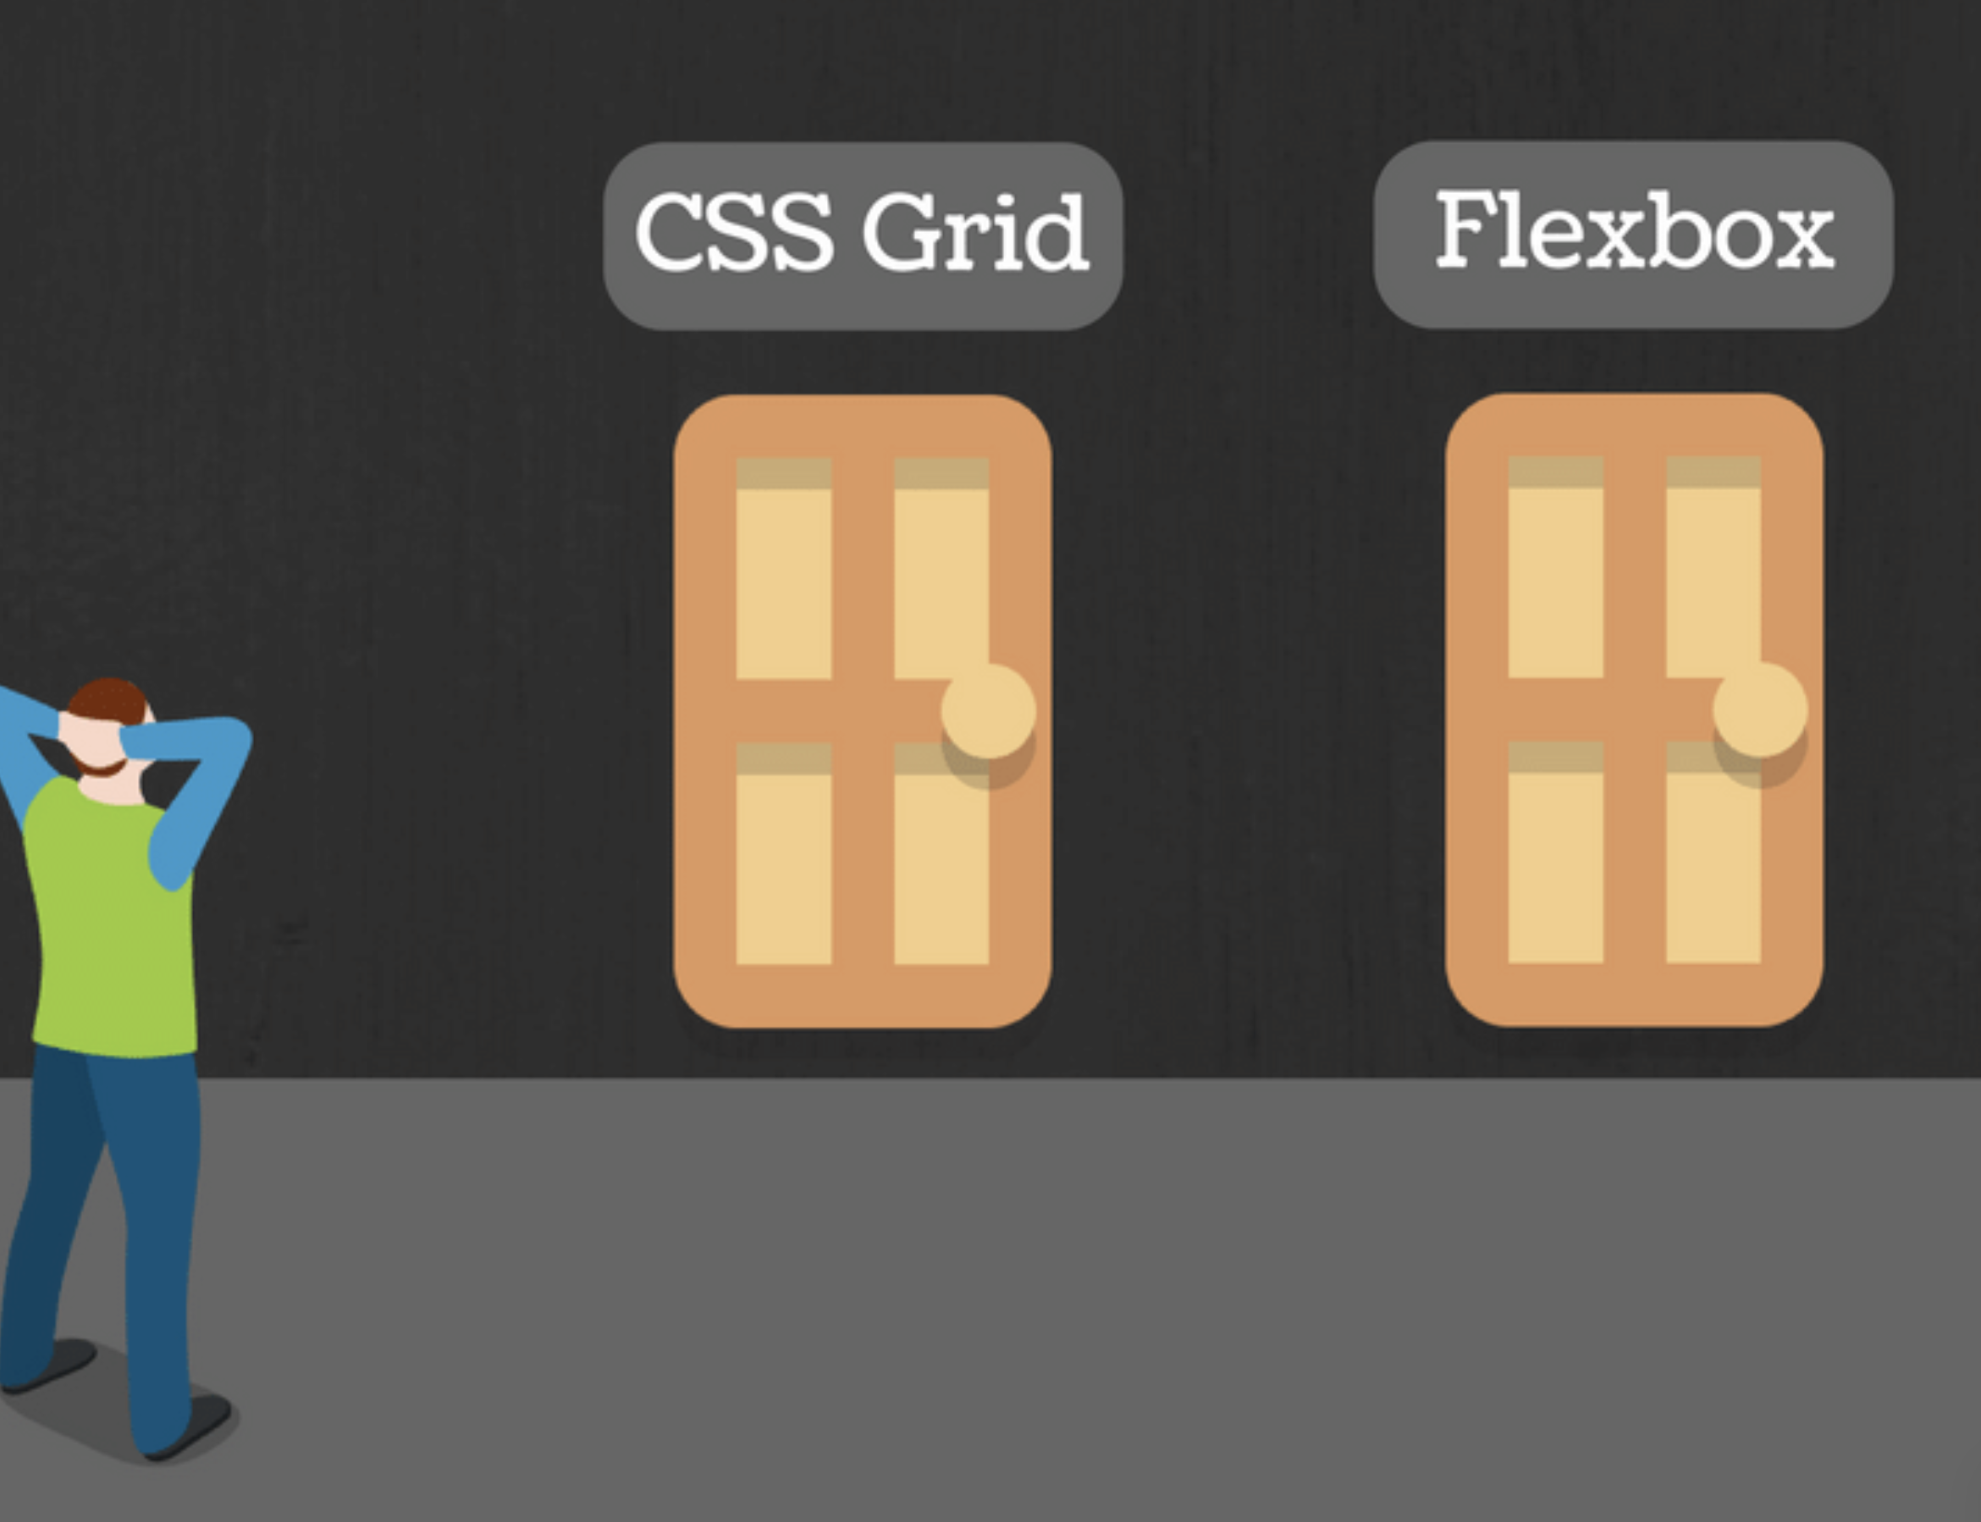
Flex or Grid?
Is this component one or two-dimensional?
If you can take your component and draw a grid over it, with rows and columns. It is two-dimensional — use grid layout for that.
If instead, you want individual items to expand within a row, without respecting what happens in the row above. That’s a flex layout.
Grid is layout first, flex is content first
If you are well aware of content’s size better Flex, if not opt for Grid

Slide 11
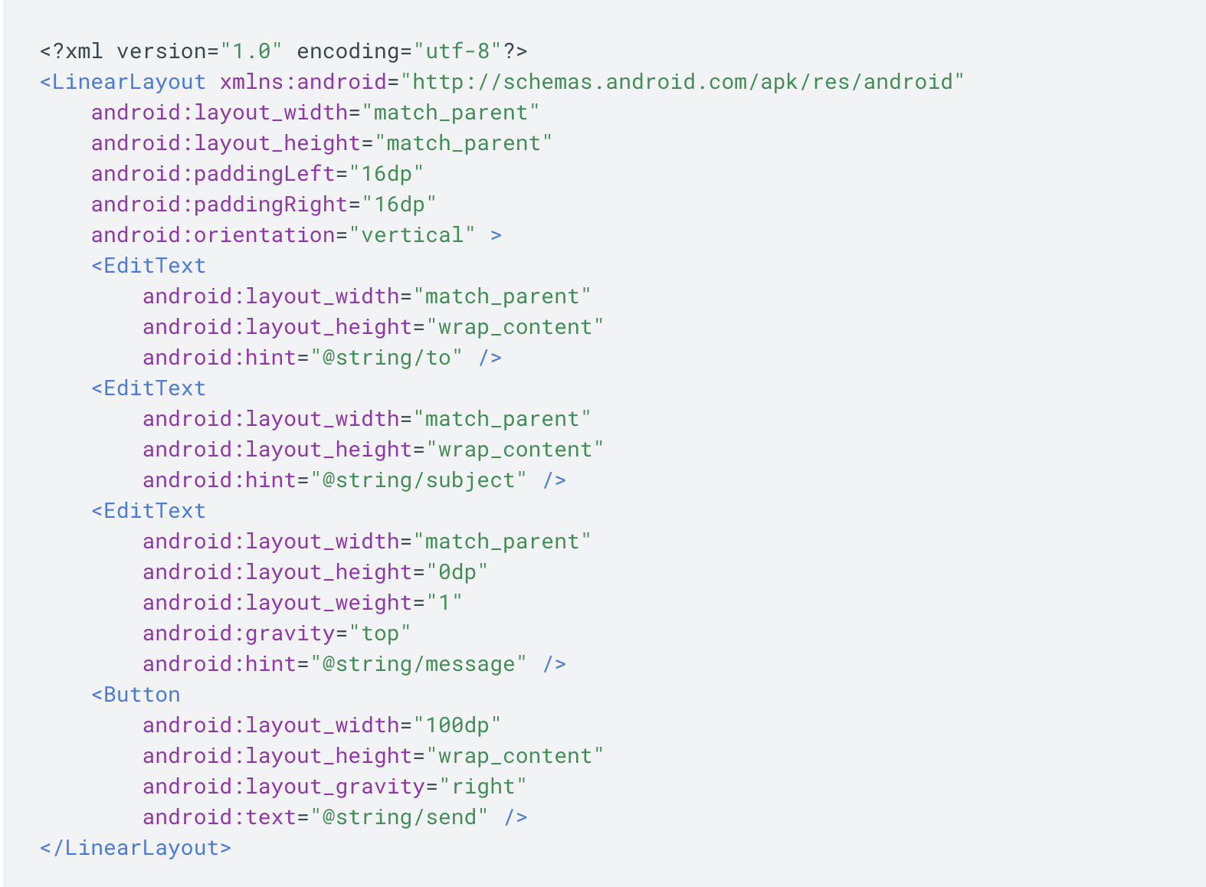
Mobile’s Version of Layouts
Android
LinearLayout
left to right
up and down
RelativeLayout
absolute
relative
iOS
StackView
samesis, left to right
up + down
Storyboard + Constraints
Drag/Place objects on storyboard in IDE UI
Add constraints to set them in a given spot

Slide 12
Sources
https://www.w3.org/TR/2018/CR-css-flexbox-1-20181119/
https://www.w3.org/TR/css3-grid-layout/
https://medium.com/youstart-labs/beginners-guide-to-choose-between-css-grid-and-flexbox-783005dd2412
https://css-tricks.com/snippets/css/complete-guide-grid/
https://css-tricks.com/snippets/css/a-guide-to-flexbox/
https://flexboxfroggy.com/
https://gridbyexample.com/
https://scotch.io/tutorials/a-visual-guide-to-css3-flexbox-properties

